Slide 1

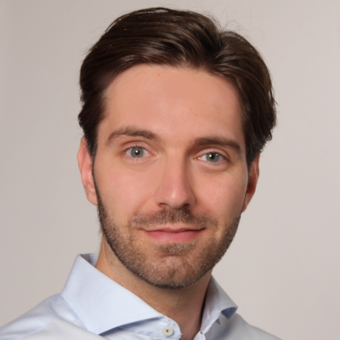
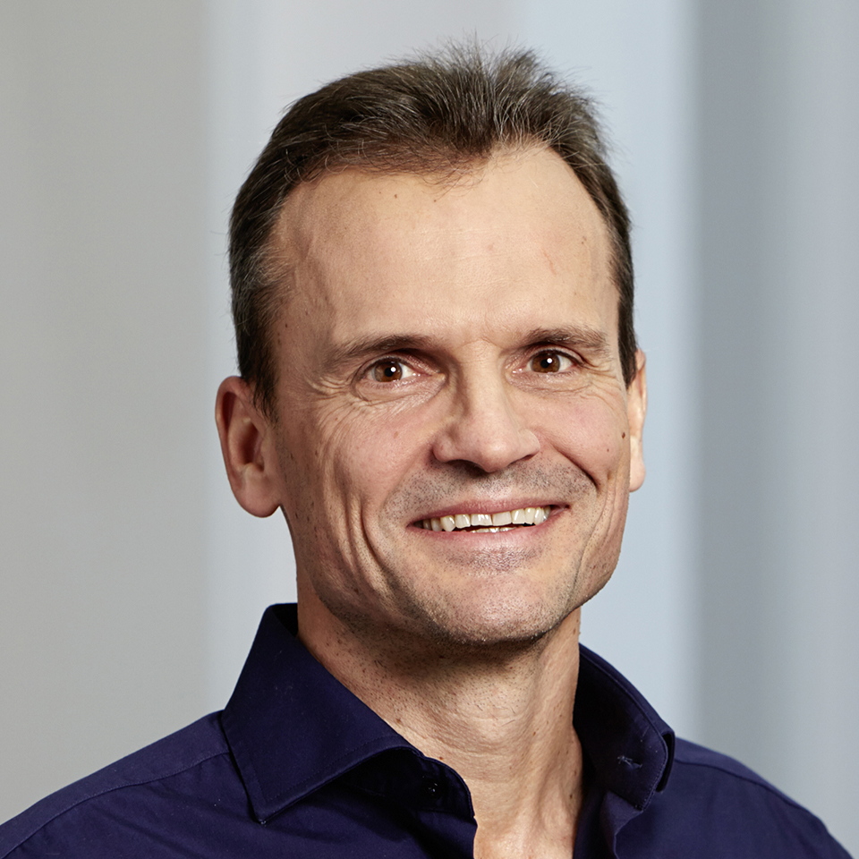

Learning Gene Regulatory Networks under
Few Root Causes Assumption
Panagiotis Misiakos, Chris Wendler and Markus Püschel
Computer Science
ICLR Machine Learning for Drug Discovery Workshop, 2023
GSK.ai CausalBench Challenge
Notes:
Hello everyone!
With my turn I will present you my team’s submission to the CausalBench competition
with title «Learning Gene Regulatory Networks under Few Root Causes assumption»

Slide 2
Linear Structural Equation Model (SEM)
Directed acyclic graph (DAG) :
Data vector on
causes of node
Linear SEM
(multiple data vectors)
Notes:
Our story begins with linear SEMs.
We assume to have a weighted DAG with weighted adjacency matrix A.
A data vector x is said to satisfy a linear SEM if the following equation holds.
In essence, the equation states that the node values occur as a linear combination of their parents values together with additive noise.
The equation for multiple samples can also be written in compact matrix format as shown.

Slide 3
Linear SEM: Closed form
Linear SEM (as a recurrence):
Linear SEM (closed form solution):
Noise : root causes
Data
Notes:
To explain our idea about root causes let’s revisit the known Fibonacci sequence.
We consider the recursive Fibonacci equation where every node occurs as the sum of the two preceeding ones.
Then we construct the corresponding DAG for the first 6 terms of the sequence.
The equations for computing the first 6 terms construct a linear SEM.
The noise in this case are the values of the first two terms.

Slide 4
Novel Assumption: Few Root Causes (plus Noise)
Linear SEM
classical case
Root causes: pollution
Data: accumulated pollution
Linear SEM
our assumption
few root
causes
noise
measurement
noise
River network

Slide 5
Our method: MÖBIUS
Our assumption
few root
causes
noise
measurement
noise
Finding the DAG:
Few root causes
Sparse DAG
Acyclicity constraint NOTEARS (Zheng et. al., 2018)
with interventions: masking matrix
Notes:
The naming comes from the coincidence with Möbius transform from combinatorics.
We solve for A via the following optimization problem.
The first term is the L^1 norm of the approximated spectra. Since L^1 is a convex relaxation of the L^0 norm, this term promotes spectral sparsity.
The other terms coincide with standard continuous DAG learning methods. The L^1 regularizer promotes sparsity to the adjacency matrix and the acyclicity term is the one from NOTEAS.
For our implementation we use PyTorch and Adam optimizer which allows for GPU acceleration.

Slide 6
Results: DAG Learning on CausalBench
(Chevalley et. al., 2022), datasets from (Replogle et. al., 2022)
Our assumptions: Linear SEM with few root causes
Ours
Ours
Provided baselines
Significant improvement over baselines
Upwards trend: Better results with increasing interventions
Notes:
In this competition we empirically evaluated our method using the CausalBench framework which uses gene expression data.
We emphasize that since we apply our method we assume that the data are generated via a linear SEM with few root causes.
We notice that even if the linearity is a strong assumption our method performs better than the baselines and shows an upward trend which means that it benefits from interventions.
In conclusion we may assume that in the given data, approximately a few genes are root causes.
This leads to the following question which is left for investigation, which is : what is the natural meaning of these dominating genes?

Slide 7
References
Bastian Seifert, Chris Wendler, and Markus Püschel. Learning Fourier-Sparse Functions on DAGs. In ICLR2022 Workshop on the Elements of Reasoning: Objects, Structure and Causality, 2022.
Xun Zheng, Bryon Aragam, Pradeep K Ravikumar, and Eric P Xing. Dags with no tears: Continuous optimization for structure learning. Advances in Neural Information Processing Systems, 31, 2018.
Gian-Carlo Rota. On the foundations of combinatorial theory i. theory of möbius functions. Zeitschrift für Wahrscheinlichkeitstheorie und verwandte Gebiete, 2(4):340–368, 1964.
Mathieu Chevalley, Yusuf Roohani, Arash Mehrjou, Jure Leskovec, and Patrick Schwab. Causalbench: A large-scale benchmark for network inference from single-cell perturbation data. arXiv preprint arXiv:2210.17283, 2022.
Joseph M Replogle, Reuben A Saunders, Angela N Pogson, Jeffrey A Hussmann, Alexander Lenail, Alina Guna, Lauren Mascibroda, Eric J Wagner, Karen Adelman, Gila Lithwick-Yanai, et al. Mapping information-rich genotype-phenotype landscapes with genome-scale perturb-seq. Cell, 185(14):2559–2575, 2022.
Notes:
This is a list of references we used in this presentation slides.

